Slide 1
Open Ecosystem & Innovation to Automate the Data-Driven Information Infrastructure Boston Storage Solution Group May 2020

Slide 2
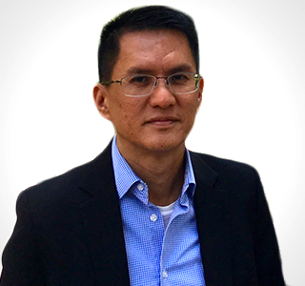
Key Project Experiences
Global engagement with customers; supported storage sales in Europe (Audi, EDF, KPN, Swisscom, Volkswagen, Vodafone), Japan (Softbank, Toyota, Yahoo! Japan, GMO, IIJ), South America (KIO, Itau, Bradesco, Vivo), Canada (Rogers, Bell), China (China Unicom, China Construction Bank Fintech) and Singapore (SingTel, Land Transport Authority, EZLink)
Chairman of SODA Foundation Governing Board. Provide vision and strategy, lead collaboration, drive execution, grow ecosystem, and engage partners, end users, and developers. Lead SODA teams across US, India & China, and working closely with DME team.
Chairman of Linux Foundation OpenSDS Project Technical Steering Committee (2016-2019).
Chief Architect for OceanStor DJ SDS controller and STaaS solutions
Key Contributions
Founded SODA Foundation (OpenSDS transformation) in Linux Foundation for open autonomous data management. Got together China Construction Bank Fintech, China Railways, China Unicom, Fujitsu, Huawei, IBM, Intel, KPN, NTT Communications, Toyota, Softbank, Sony, Southwest Airlines, Vodafone, Wipro, Yahoo! Japan etc. to collaborate in SODA.
Founded the Linux Foundation OpenSDS Project bringing in industry leaders Dell EMC, Fujitsu, Hitachi, Huawei, Intel and Vodafone to collaborate on open source software-defined storage (SDS) management. OpenSDS attracted global leaders IBM, KPN, Toyota, NTT Communications, and many others to join in its 3 years of development
Speaker at Huawei Analysts Summit 2018, Huawei Japan IT Day 2019. Member talks at Huawei Connect 2017/18/19.
Frequent speaker at global industry events including Linux Foundation Open Source Summits (Europe, North America, Japan, China), CloudNativeCon+KubeCon (Europe, North America), SNIA Storage Developer Conference, Flash Memory Summit, China Unicom WoCloud Summit, Open Source India, IEEE, OSCON etc.
Strategy and architecture planning for OceanStor DME with SODA, and OceanStor DJ with OpenSDS
Steven Tan
ID: 759304
VP & CTO Cloud Solution, Storage
Specialty:
cloud native, virtualization, SDS, cloud storage, data management, open source technologies
Dept.:
Boston Intelligent Computing and Data Lab
Communication Level :
CxO, VP, architects, DevOps, developers, investors, analysts and media
Ready for Support
Global support in N. America, Europe, S. America, China, Japan and APAC. Joint Innovation Solutions with customers
Host SODA events worldwide (conferences, seminars, meetups, webinars). Give talks at Huawei conferences.
Background: Co-founder/CTO Cloudena (cloud, virtualization, object storage), VP Engineering ProphetStor (SDS), VP Engineering and Technology CipherMax (SAN, data security, embedded systems)
US citizen. English and conversational Chinese. Singapore NUS & NTU alumnus.

Slide 3
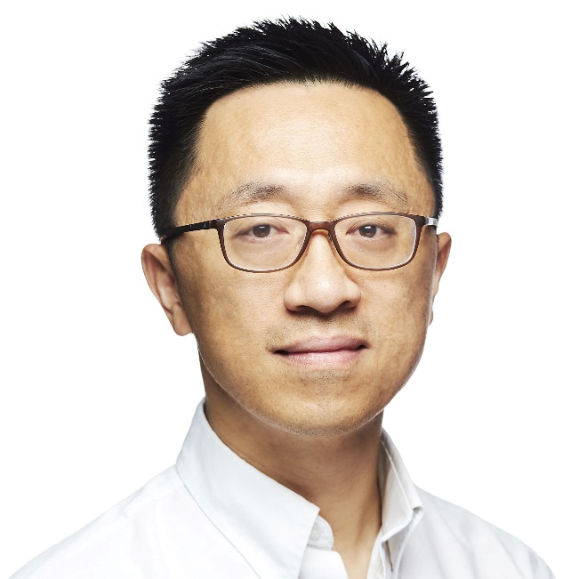
Key Domain & Key Project Experiences
AI and Big Data
Futurewei Wenju Project: first-of-a-kind platform for accelerating enterprise AI and big data solutions
Futurewei Caerus Project: exploit synergy of compute and storage to improve performance of AI and big data systems
IBM Watson Health Cloud: industry’s first GxP-compliant big data platform for cognitive health applications
Cloud
IBM SmartCloud Services: IBM’s initial portfolio of cloud service offerings, spanning IaaS, PaaS, and MaaS
IBM Cloud OpenStack Services: first managed OpenStack private cloud offering in the world
IBM Cloud Managed Services: cloud-management-as-a-service offering with revenue in the billions of dollars
Outstanding contributions
VP and CTO of AI and Data Infrastructure at Futurewei
Formerly Director and CTO of IBM Watson Health Cloud, IBM Distinguished Engineer, IBM Master Inventor
Fellow of the IEEE, Past Editor-in-Chief of IEEE Transactions on Cloud Computing, Past Chair of IEEE Technical Committee on Business Informatics and Systems
Recipient of the prestigious IEEE Computer Society Technical Achievement Award
Honorary professor titles at Hong Kong University of Science and Technology, Huazhong University of Science and Technology, Fudan University, Sun Yat-Sen University, and Hong Kong Polytechnic University
Author of 80+ patents
Hui Lei, PhD, FIEEE
ID: 00497286
VP and CTO, AI and Data Infrastructure
Speciality:
Intelligent Data, AI Engineering, Cloud Computing
Department.:
Boston Intelligent Computing and Data Lab
Communication Level :
CxO, VP, analysts, architects, engineering, research, academia, media, conferences, expos, industry summits
Ready for Support
Well versed in the state of the art and the state of the practice in big data, AI, and cloud
Extensive experience in strategy planning and execution, idea generation and innovation leadership, customer engagements, and C-suite executive interactions
Internationally recognized technology leader, frequent keynote speakers in international forums
US citizen, fluent English and Chinese

Slide 4
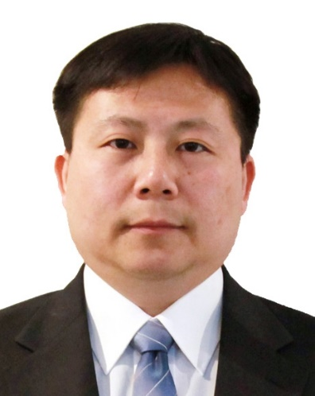
Key Project Experience
20 years experience in the enterprise storage (EMC), network (Cisco) and HCI (HPE).
Support numerous enterprise customers across continents including Europe, Asia and US.
Contribute to multiple key technical projects for Huawei storage products.
Zhihao Tang
Outstanding contributions
ID: 00444530
Senior Architect
Specialty:
Enterprise and Distributed Storage Solutions
Hyper Converged Infrastructure (HCI) & Software Defined Storage (SDS)
Big data solutions
Dept.:
Futurewei Storage and Compute Division
Communication Level :
CxO, VP, Strategy Manager, Architect, HW/SW Engineer, Procurement/Sales, etc.
Customer Value & Huawei Value:
Strong Technical Background with Deep Understanding of Huawei’s Storage Product Line
Senior Architect in the Futurewei Storage Lab
20 years of IT industry Working Experience
Contribute to Huawei storage’s major technical architectures – Frontend AA (Dorado), FusionStorage (ROC)
Ready for Support
Understanding of Huawei Storage Product offerings and technical details.
Technical support experiences.
US citizen.
Languages Spoken: English and Chinese.

Slide 5
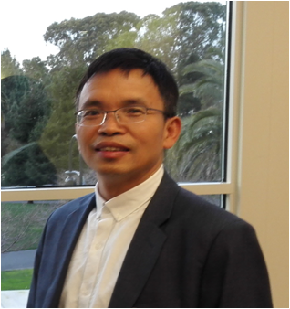
Key Project Experience
2017-2019 UAE G42 HPC & AI Projects Technical Maketing, Solutions & Support
2016-2019 Saudi Arabio Aramco HPC & ST 5G Project Technical Marketing & Solutions, etc.
2018-2019 Intelligent Weather Forecast PoC with National Meteorological Center of CMA, China
2015-2019 Numerous Server, Server Virtualization, HCI, Big Data and AI Technical Workshops with France Orange Group/OBS/OFR, France Free, Telecom Italia, Italy Wind, Deutsche Telekom AG, Telefónica Germany, Vodafone, etc.
Chief Architect for Huawei E9000 Converged Blade & Atlas 5500 Heterogeneouss Computing Platform
Outstanding contributions
Jinshui Liu
Customer Value & Huawei Value:
Strong Technical Background with Deep Understanding of Huawei Intelligent Computing & Storage Products
Distinguished Technologist of Futurewei Intelligent Computing & Data Lab
8-Year Chief Architect for Huawei IT Hardware & Intelligent Computing, led the many products architecture designs including OSCA E9000 Converged Blade Server, Atlas 5500 Heterogeneous Computing Platform. Atlas 500 Intelligent Edge, and PANGEA V5 All Intelligent, All NVMe Flash, All IP & Scale at Will Storage System Hardware Architecture, etc.
13-Year Working experiences at Huawei/Futurewei, many years experiences of overseeing IT Hardware Technology & Product strategic planning and development, one of initiators of Huawei Converged Infrastructure, Hyper Converged Infrastructure, Heterogeneous Computing, CE12800 Data Center Switch & PANGEA All Intelligent, All NVMe Flash, All IP & Scale at Will Storage System
30-Year Hands-on Experiences in Data Center Compute, Networking and Storage, HPC, Heterogeneous/Intelligent Computing, Wireline and Wireless Networking System Architecture Design & Product Development
ID: 00073765
Distinguished Technologist
Speciality:
X86 & ARM64 Computing & Servers
HPC System Hardware & Software Stacks
AI Deep Learning Training & Inferencing System & Optimization
HCI & Storage Hardware System Architecture
Data Center Networking Architecture
Dept.:
Futurewei Intelligent Computing and Data Lab
Communication Level :
CxO, VP, Strategy Manager, Architect, HW/SW Engineer, Procurement/Sales Team, Consulting Company, etc.
Ready for Support
Very deep understanding of Huawei Product offerring and technical details.
Previous sales and technical support for European & Middle East sales support for Huawei.
US lawful permanent resident with excellent communication skill in English and Chinese, deep understanding European cultures.

Slide 6
Open Ecosystem & Innovation to Automate the Data-Driven Information Infrastructure Boston Storage Solution Group May 2020

Slide 7
Huawei’s Ecosystem Philosophy and Effort

Slide 8
Huawei’s Ecosystem Philosophy and Effort
Key Messages
Ecosystem is important to the growth of any business, creating opportunities for innovation together with new challenges
Huawei has invested billions in building ecosystems, establishing principles and guidelines to grow successful ecosystems
Huawei open source participation has contributed to the rise of many popular open source projects, and has been critical to the success of Huawei ecosystem development
Ecosystem Philosophy
SODA
ARM
AI for Data Infrastructure
Open Storage
Data Lakes for Big Data & AI

Slide 9

NOKIA’s Burning Platform
In February 2011, Nokia CEO Stephen Elop wrote an email likens Nokia’s situation to “a man on a burning oil platform”
Market share shrunk from 48% in 2007 to 24% 2011
Market cap down from €110B in 2007 to €14.8B by May 2012
“Our competitors aren’t taking market share with devices, they are taking market share with an entire ecosystem.” - Nokia CEO Stephen Elop
Notes:
Elop was brought onboard as CEO in Sep 2010 to lead Nokia out of trouble. He wrote the famous 'burning platform' email to his employees, to stress the drastic change that must happen to save Nokia. He highlighted that competitors were winning not by how good their mobile phones were, but how their mobile phones allow users to connect to an entire ecosystem

Slide 10
“Every once in a while, a revolutionary product comes along that changes everything.”
- Apple CEO Steve Jobs
“Apple disrupted the market by redefining the smartphone and attracting developers.”
- Nokia CEO Stephen Elop
Ecosystem Philosophy
SODA
ARM
AI for Data Infrastructure
Open Storage
Data Lakes for Big Data & AI
Notes:
He was talking about Apple who was leveraging the power of developers to build the Apple ecosystem and redefining the smartphone.
Despite recognizing the problem, Nokia failed on their ecosystem development, and market share dropped to less than 5% in 2013.

Slide 11
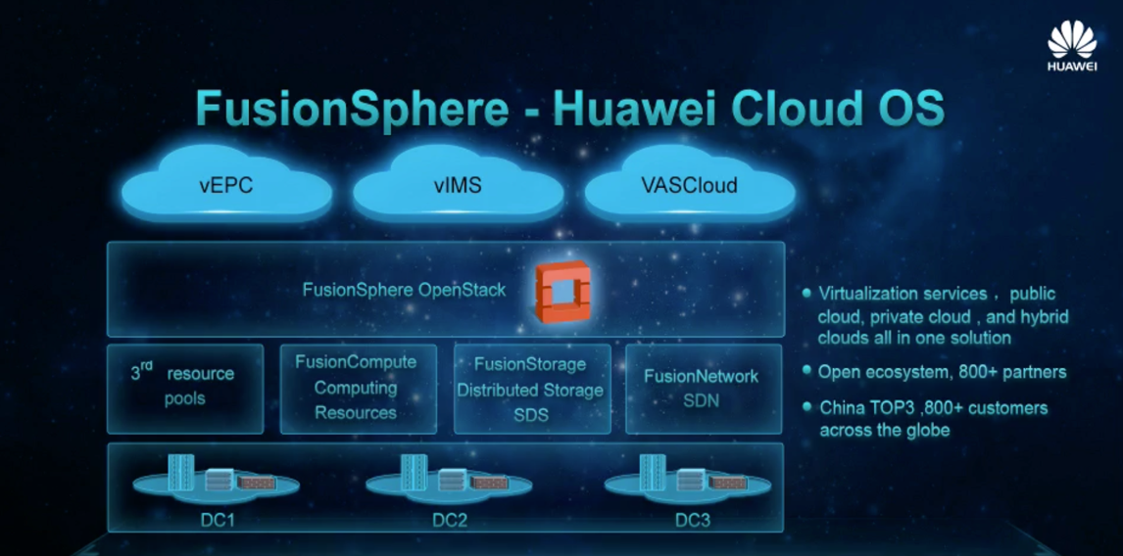
Huawei Ecosystems
Oct 27 2016
Building the OpenStack Ecosystem by Embracing Open Source and Contributing to the Open Source Community
Aug 9 2019
Huawei will invest $1 billion to build HarmonyOS’ ecosystem
Mar 27 2020
Huawei is investing $200m this year to build an ecosystem around its Kunpeng ARM-based server processor
Ecosystem Philosophy
SODA
ARM
AI for Data Infrastructure
Open Storage
Data Lakes for Big Data & AI
Notes:
Huawei knows the importance of ecosystems, and has invested in building ecosystems for different product lines and industries. eg. OpenStack for Huawei Cloud and FusionSphere, Harmony OS for seamless cross-device user experience, HMS Huawei Mobile Services app store for Huawei phones, and the Kunpeng ARM-based processor.
HarmonyOS has 1.4 million developers on board by the end of March, up 115% from the end of the first quarter of 2019.
Huawei is developing the Kunpeng ecosystems in several key Chinese cities including Beijing Shanghai, Nanjing, Xiamen which have huge potential corporate computing markets.

Slide 12
Building Ecosystem Challenges
Hardware Compatibility
Software Compatibility
Applications Availability
Industry Consensus
Developers Ecosystem
Standards
BUILDING ECOSYSTEM IS TOUGH!
Ecosystem Philosophy
SODA
ARM
AI for Data Infrastructure
Open Storage
Data Lakes for Big Data & AI
Notes:
Building an ecosystem is a must for every business today.
A successful ecosystem requires many upstream and downstream enterprises, developers, users and other industry players to work together to tackle challenges with hardware, software, applications, and more. Just like conquering a mountain, you may plan as much as you can, but it is hard to know all the challenges ahead until you embark on it.

Slide 13
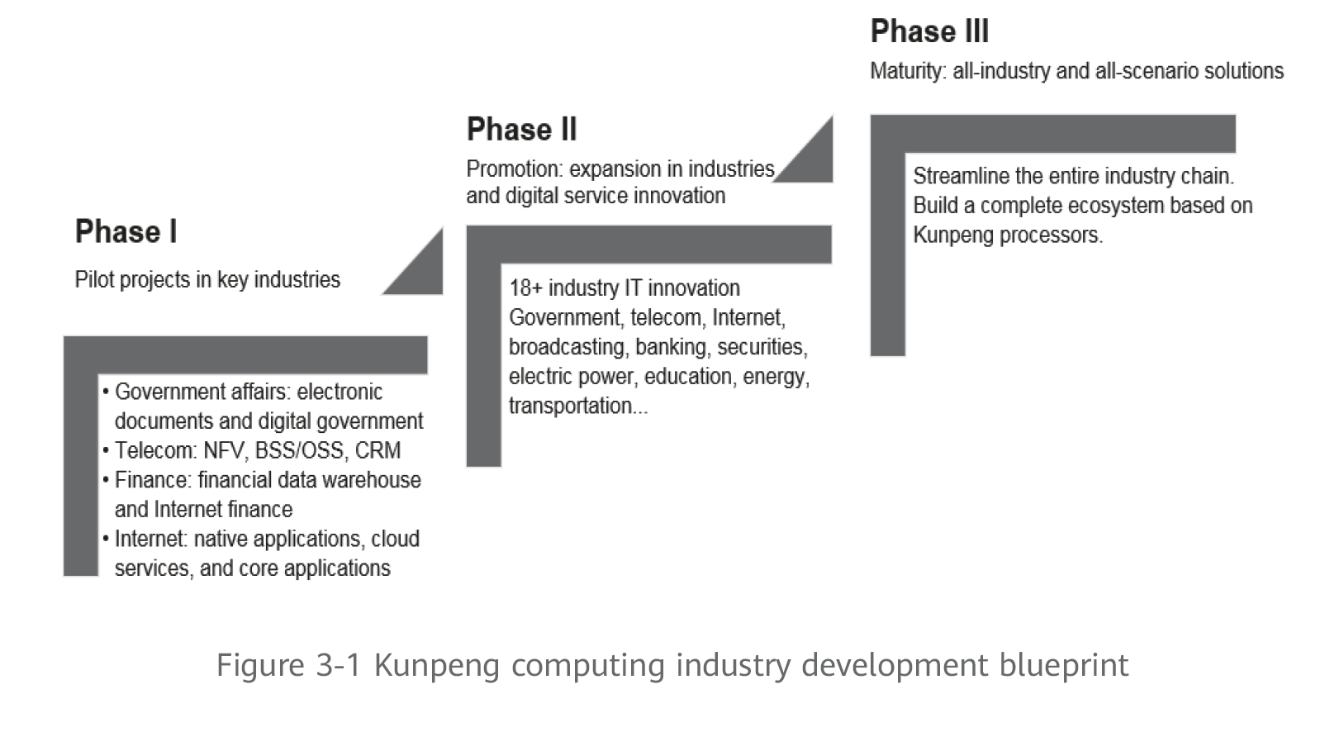
Huawei Ecosystem Development Blueprint
Ecosystem Philosophy
SODA
ARM
AI for Data Infrastructure
Open Storage
Data Lakes for Big Data & AI
Notes:
Through the years, Huawei has developed a set of blueprint and guidelines to build our ecosystem.
This is the blueprint for the Kunpeng ecosystem development. It adopts a 3-phase approach. Phase 1 is identifying key industries and building pilot projects for them to incubate industry capabilities and build vendor confidence. Phase 2 expands the reach to additional industries and building a firm foundation for further innovation. Phase 3 is when the ecosystem is mature enough to meet the needs of any industry

Slide 14
Development Steps
DEVELOPING INDUSTRY ORIENTED APPLICATIONS
We will work with industries and sectors such as government, telecoms, Internet, broadcasting, finance, securities, electric power, and energy, to build a complete industry ecosystem and to provide competitive solutions covering all scenarios in all industries.
INTEGRATION OF INDUSTRIES BY REGION
We will build regional Kunpeng ecosystem innovation centers based on the advantages and software ecosystems specific to regions. We will focus local resources to develop software ecosystems, gradually expand the industry space, and cultivate local talent. Then, over time, a global Kunpeng ecosystem can gradually develop
BUILDING ALLIANCES AND INCUBATING INDUSTRY STANDARDS
We join hands with industry alliances to build an open standards system and define scenario-based standards for new applications to ensure healthy and sustainable development of the Kunpeng computing industry as a whole.
CULTIVATION OF A COMMUNITY OF DEVELOPERS
Building the Kunpeng Developer Community into a mainstream will be an important way to develop the software tools needed for chip optimization in open-source operating systems. In addition, the basic capabilities of the Kunpeng processor are opened through Kunpeng boards and components to enable developers.
Ecosystem Philosophy
SODA
ARM
AI for Data Infrastructure
Open Storage
Data Lakes for Big Data & AI
Notes:
These are the steps that we will have to go through to go to achieve ecosystem maturity.

Slide 15
What To Develop
HARDWARE
Provide reference designs, vendor support
SOFTWARE
Develop open source, toolkits, libraries, and drivers
APPLICATIONS
Aggregate and integrate leading industry applications
INDUSTRY POLICIES
Develop industry and regional best practices together with users, vendors, ISV’s, and industry associations
OPEN SOURCE COMMUNITIES
Enable vendors & developers to collaborate on software development. Enable users to try and adopt open source software
DEVELOPERS
Work with industry and universities to grow developers with development tools, training and certification programs
STANDARDS
Establish open and unified hardware, software, tests and other standards with industry associations and consortiums
Ecosystem Philosophy
SODA
ARM
AI for Data Infrastructure
Open Storage
Data Lakes for Big Data & AI
Notes:
In order to do that, we have to develop hardware, software, open source communities, developer network, and a bunch of other things in parallel.

Slide 16
Open Source Principles
OPEN DESIGN
OPEN COLLABORATION
OPEN COMMUNICATION
transparent and open process for planning and designing
create a vendor-neutral level playing field
gives everyone an equal opportunity for participation
architecture, design, roadmap documents are public
design concepts and architectures are openly shared
work openly with developers, users, partners, and co-petitors
work across geographies, cultures, and languages, online and in-person
verbal (via online/offline meetings and conferences) and nonverbal (via Github discussions, forum, wiki, website, FAQ, social media, etc.) .
establishes an environment where all project participants have a good understanding of the goals and what
Ecosystem Philosophy
SODA
ARM
AI for Data Infrastructure
Open Storage
Data Lakes for Big Data & AI
Notes:
Our open source development is based on 3 principles. Open Design, Open Collaboration and Open Communication

Slide 17


Huawei Open Source Participation
Huawei has been a leader in >15 mainstream open source communities, including Linux, CNCF, Apache, OpenStack, and OPNFV.
Huawei’s contribution has ranked No.2 in OpenStack for consecutive years, No.4 in CNCF, and No.5 in Linux kernel
Huawei has contributed to multiple open-source projects, including
Cyborg in OpenStack
CarbonData in the big data community
KubeEdge in the cloud native community
ServiceComb in the microservice domain
SODA in data and storage, & its predecessor OpenSDS (storage)
OpenEuler Linux for Kunpeng and other processors
Ecosystem Philosophy
SODA
ARM
AI for Data Infrastructure
Open Storage
Data Lakes for Big Data & AI
Notes:
Huawei has participated in many open source projects, and contributed to the rise of popular projects such as OpenStack and CNCF. SODA and OpenEuler are the two newest projects initiated by Huawei.

Slide 18
ARM Powered Hardware and Software Stacks

Slide 19
ARM Powered Hardware and Software Stacks
Key Messages
ARM64 Hardware Ecosystem is Mature with Six vendors offering high-performance competitive SoCs based on the compatible ARMv8.x ISA; and ARM64 servers available from a dozen of OEM/ODM vendors including Huawei
ARM64 Software Ecosystem is Maturing and optimized rapidly with the ARM64 industry and community making significant progress everyday; a lot of application porting tools are available and codes written in interpreted languages, such as Java, NodeJS, Python, Go etc., could run on ARM64 without any change
Huawei is committed to promoting ARM64 products, industry and ecosystem; and our ARM64/KunPeng Computing strategy is: Be an Enabler, Focus on Processor and Cloud Services, Stick to Partners First, Will not compete with partners, will invest $200M in 2020 and $400M+ in next 5 years in fostering ARM64/KunPeng Computing Ecosystem
Ecosystem Philosophy
SODA
ARM
AI for Data Infrastructure
Open Storage
Data Lakes for Big Data & AI
Notes:
Growth is accelerating due to technologies like 5G, AI, and Edge/IoT
We need to change, since the current model does not scale
Huawei will partner with the customers to deploy our leading-edge solution
One Storage, One Lake architecture and One Data feature
OpenAPIs, Open Source ecosystem support, partnerships and collaboration

